Slide 1
Numerical Implementation of the Redfield Master Equation
Wenxiang Ying
11/19/2023

Slide 2
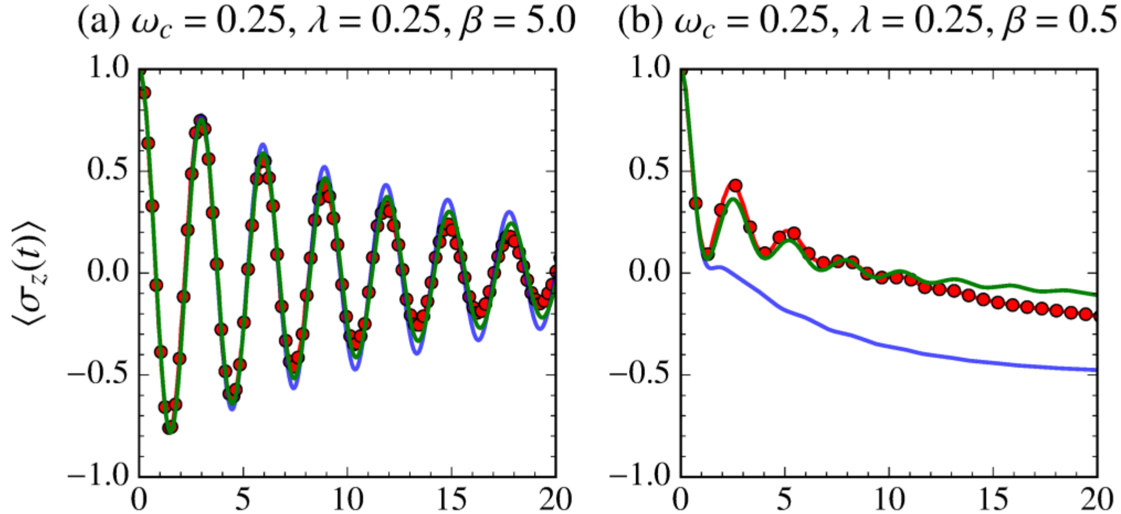
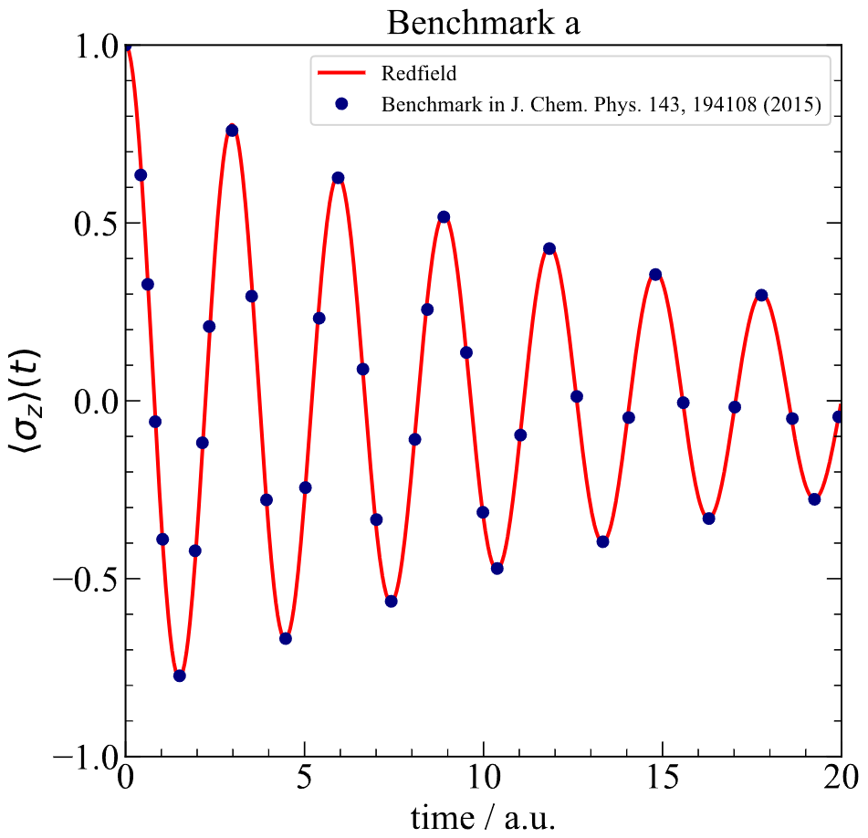
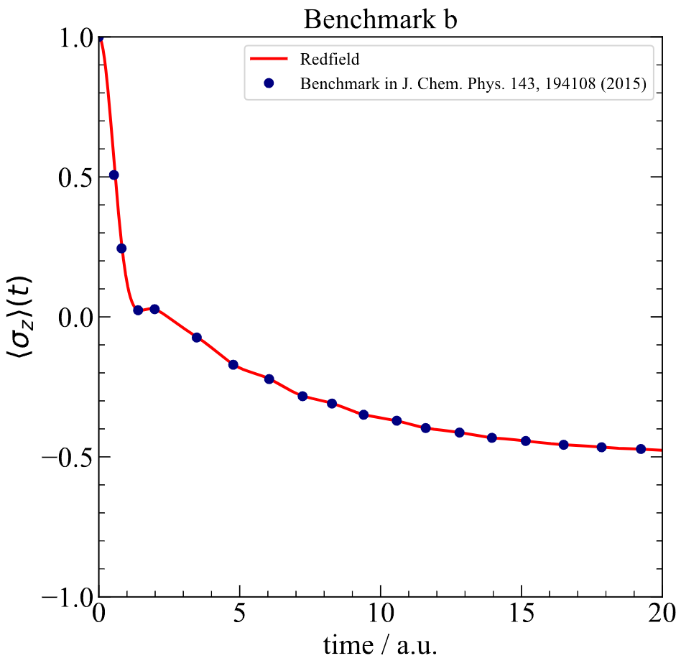
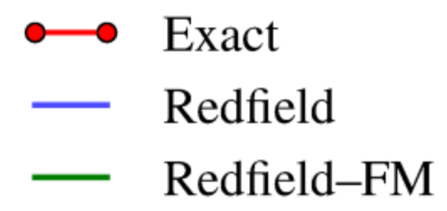
Reproduction of literature results
A. M.-Castillo, T. C. Berkelbach, and D. R. Reichman,
J. Chem. Phys. 143, 194108 (2015)
Reproduced Results

Slide 3
Spin-boson models with Ohmic spectral density
Bath modes discretization scheme:
I. R. Craig, M. Thoss, and H. Wang, J. Chem. Phys. 127(14), 144503 (2007)
H. Wang, J. Phys. Chem. A 118(39), 9253–9261 (2014)

Slide 4
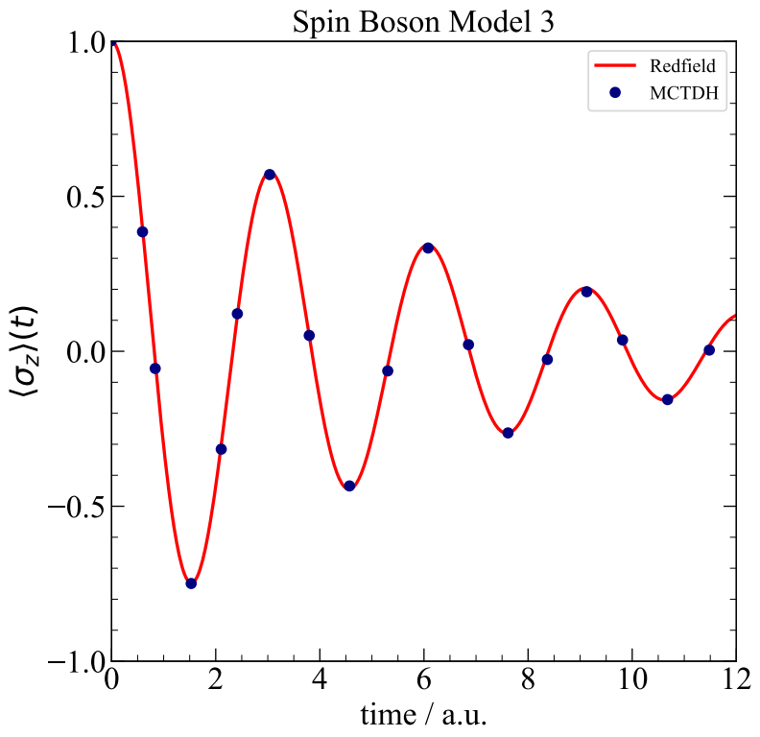
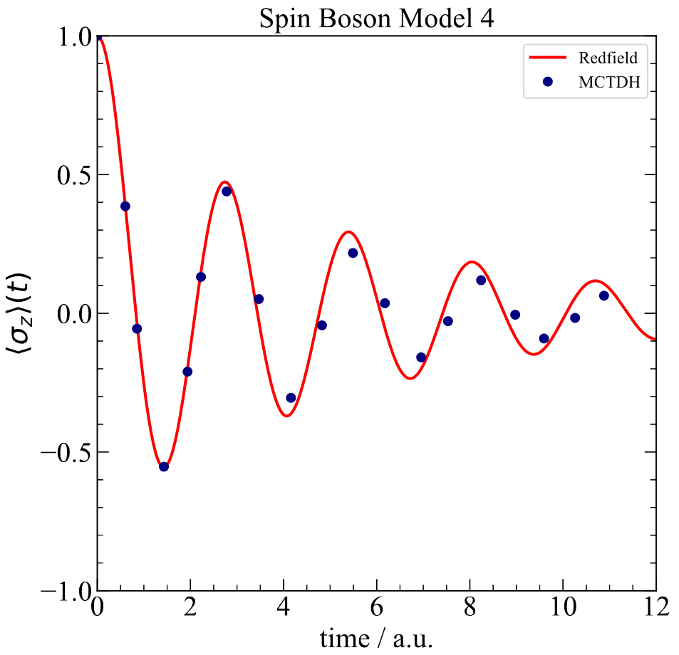

Slide 5
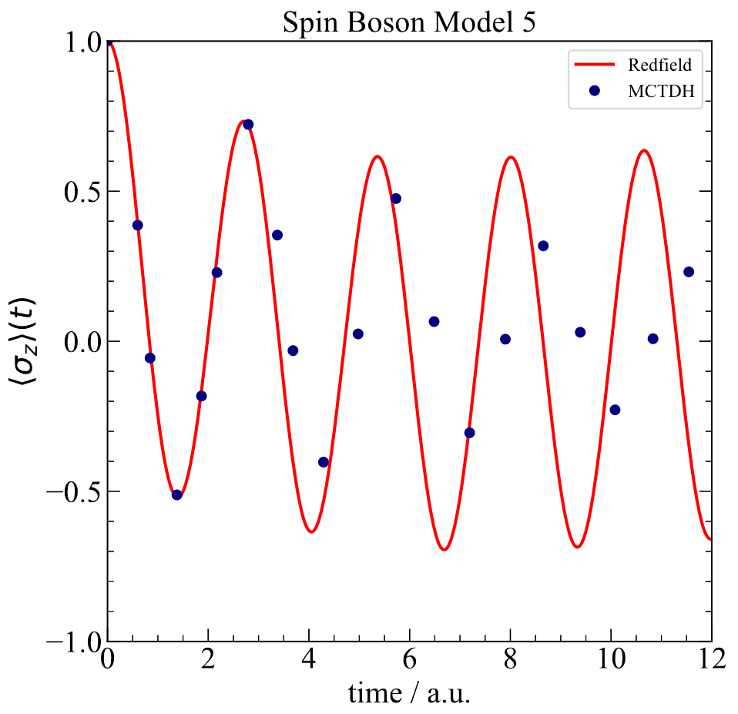
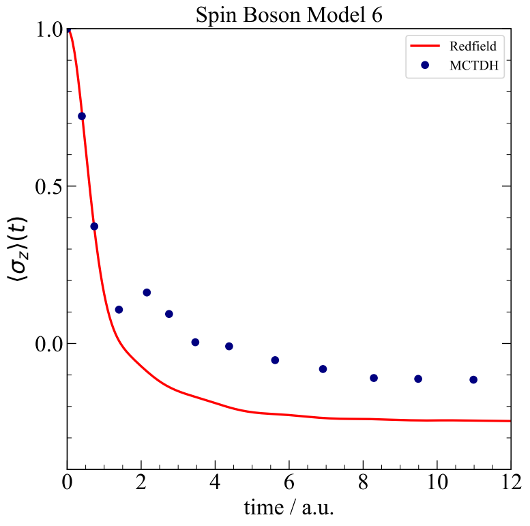

Slide 6
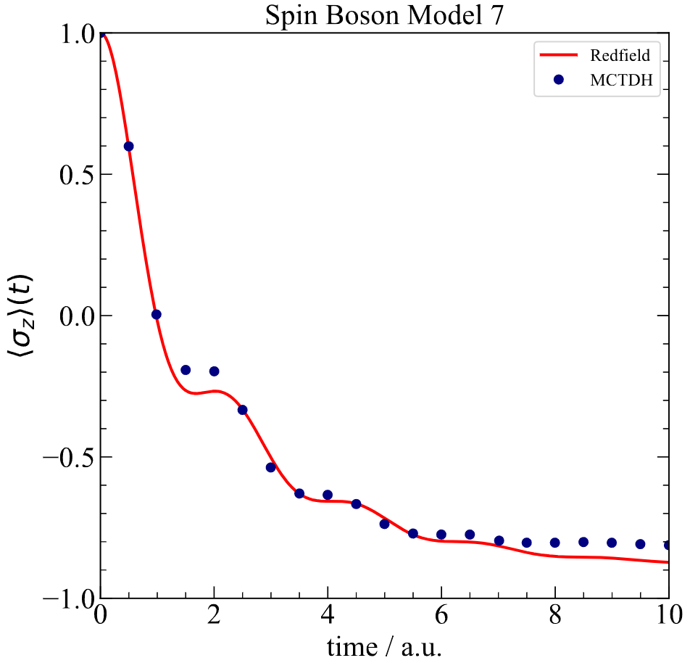
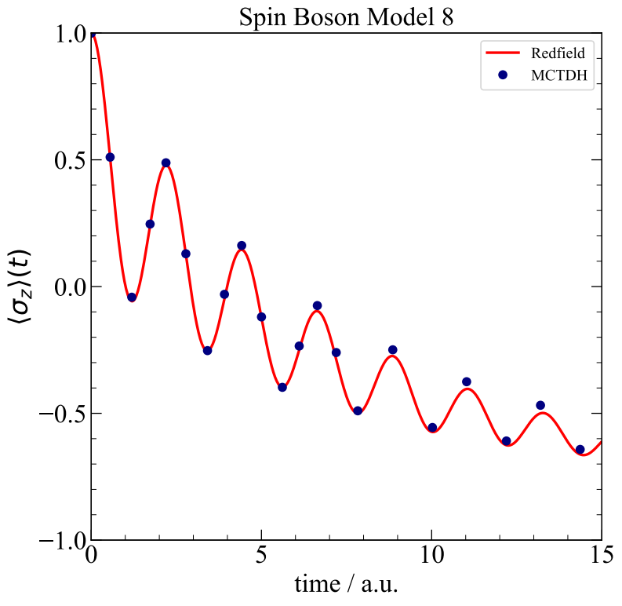

Slide 7
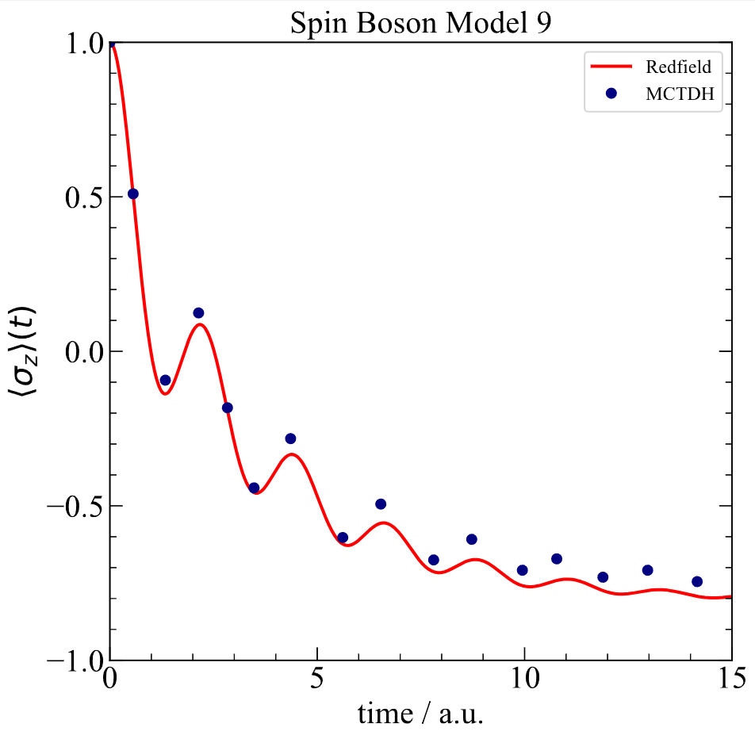
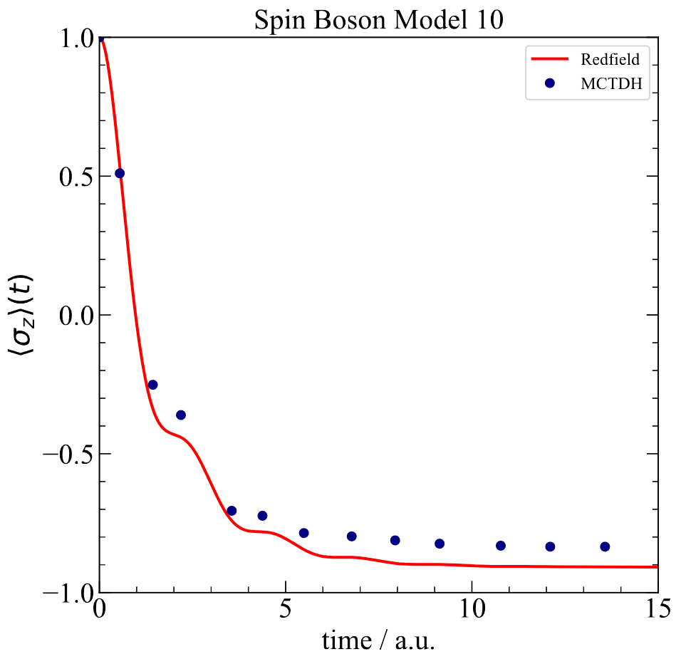

Slide 8
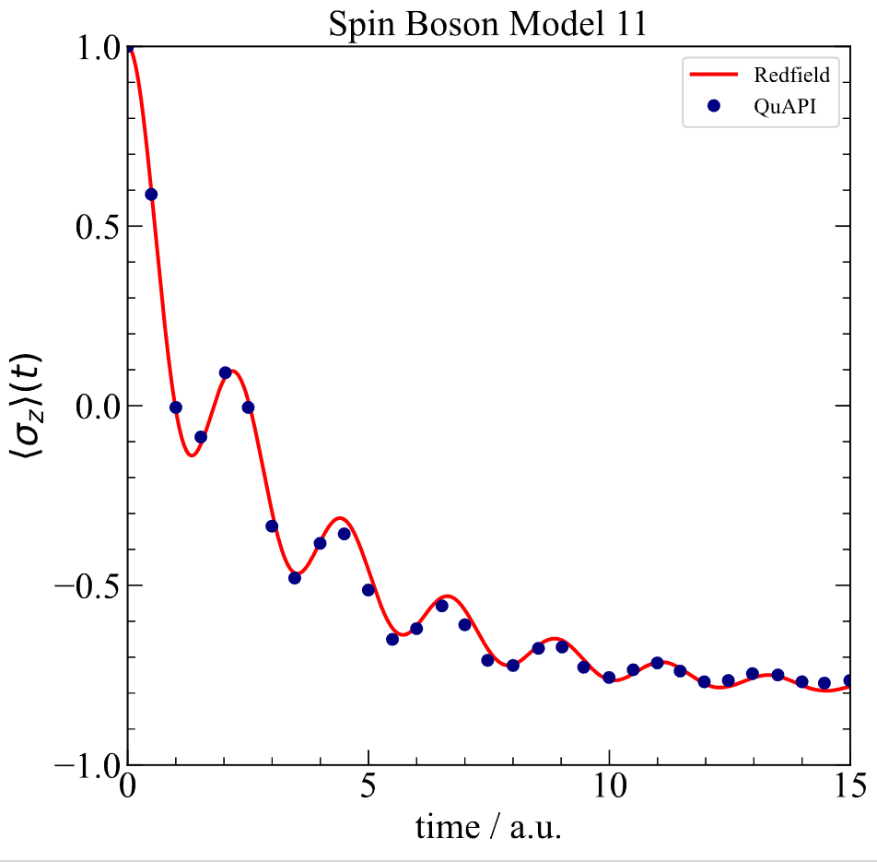

Slide 9
Spin-boson models with Debye spectral density
Bath modes discretization scheme:
I. R. Craig, M. Thoss, and H. Wang, J. Chem. Phys. 127(14), 144503 (2007)

Slide 10
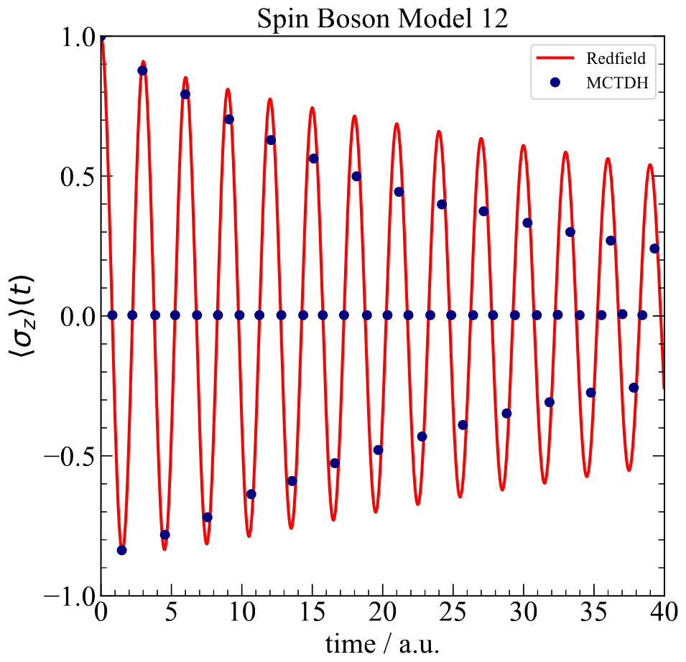
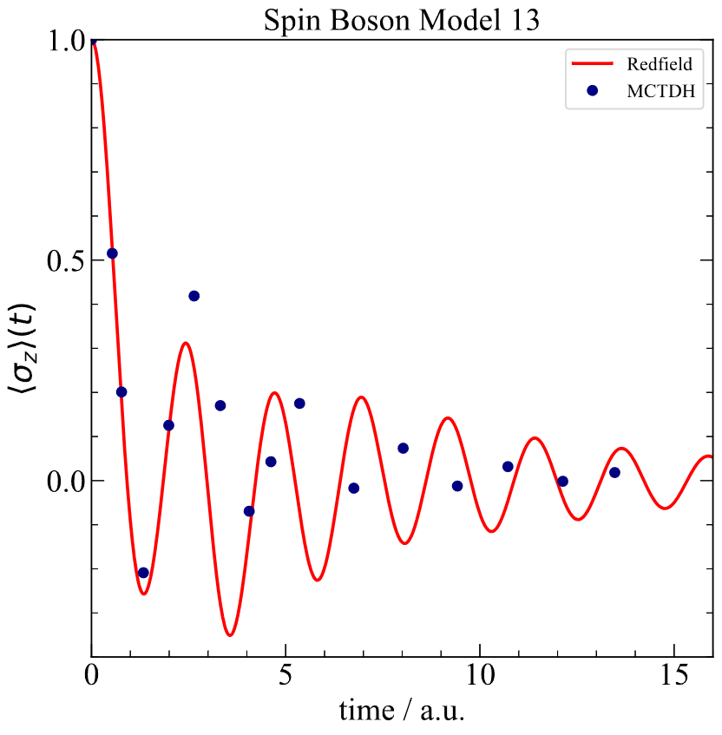

Slide 11
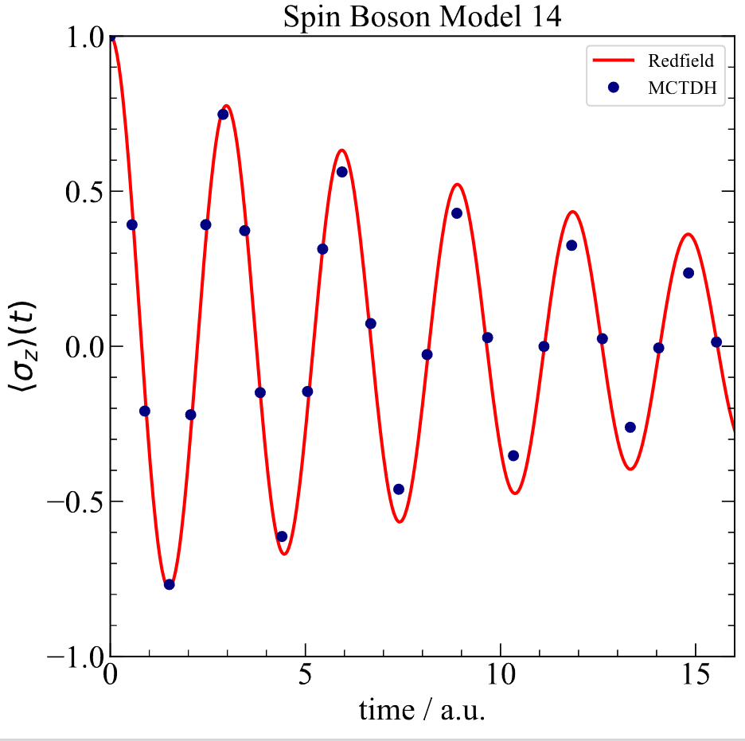
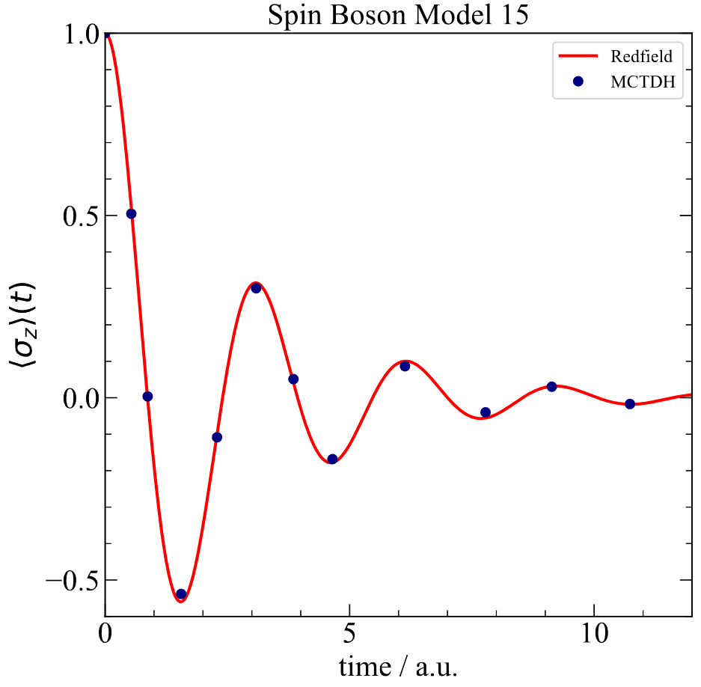

Slide 12
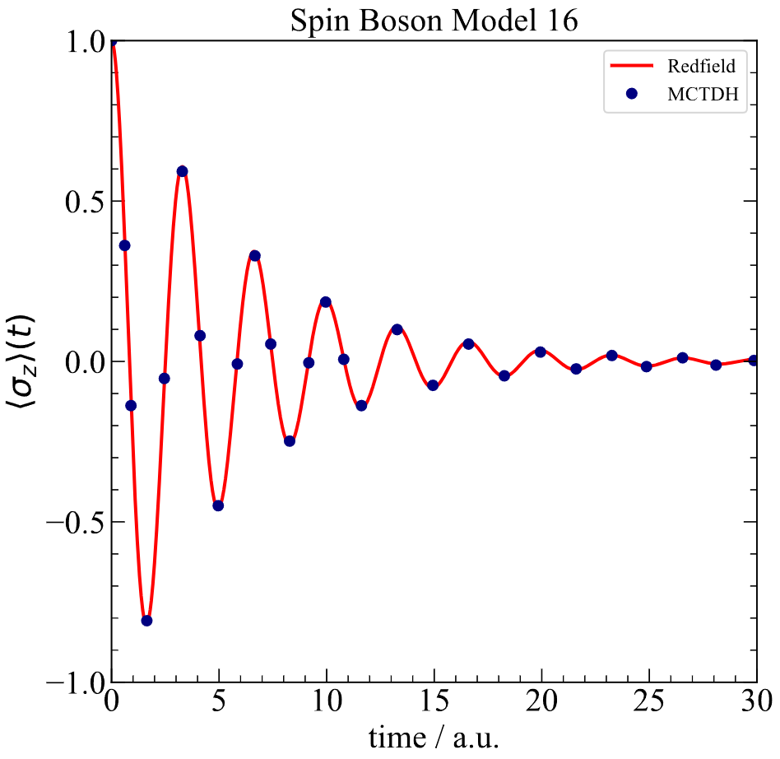
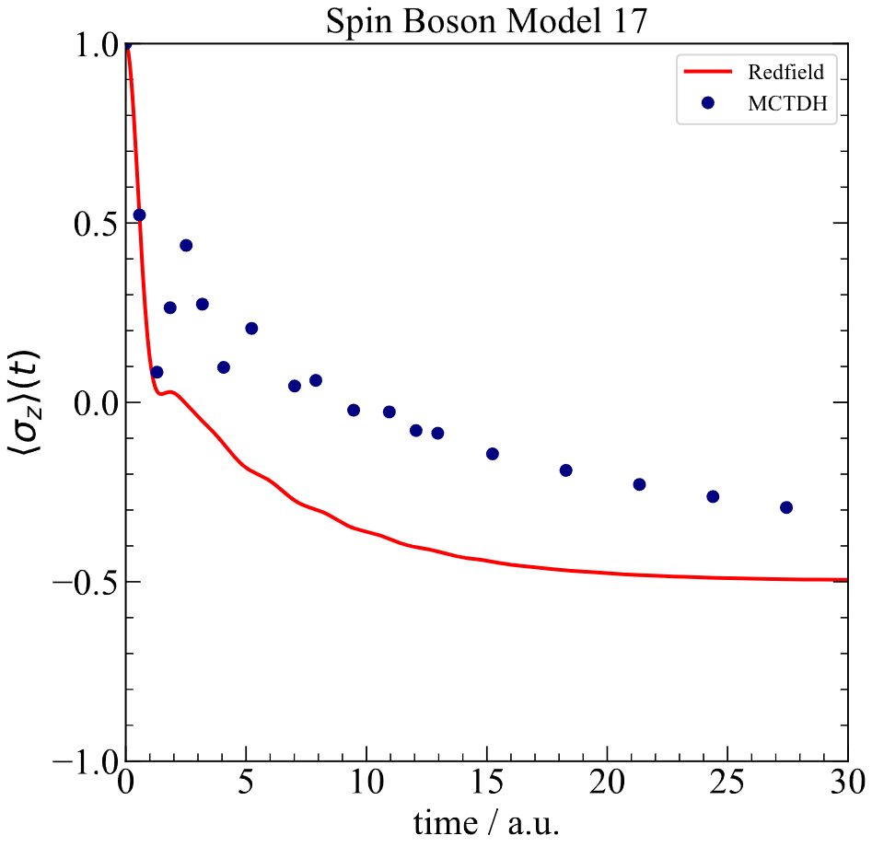

Slide 13
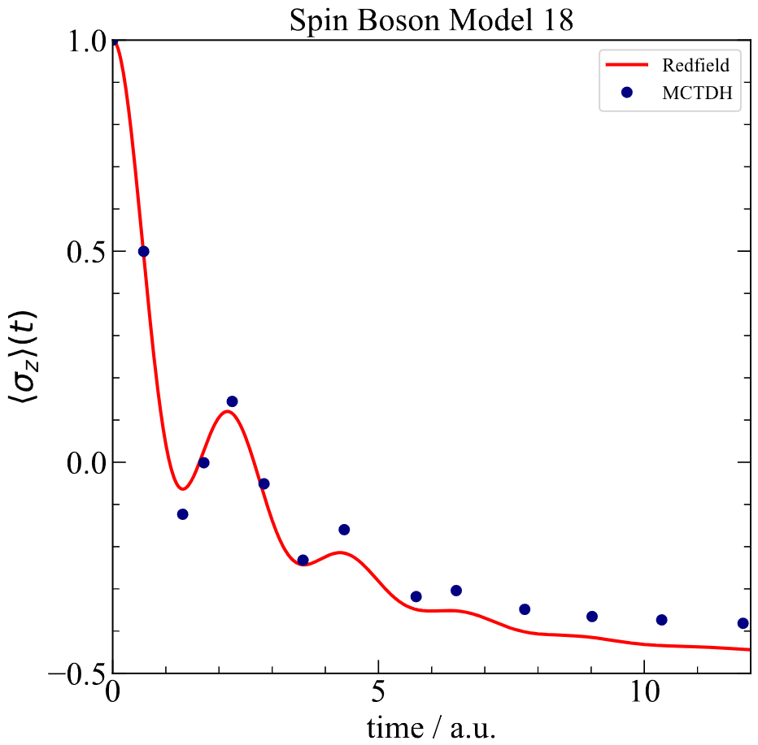
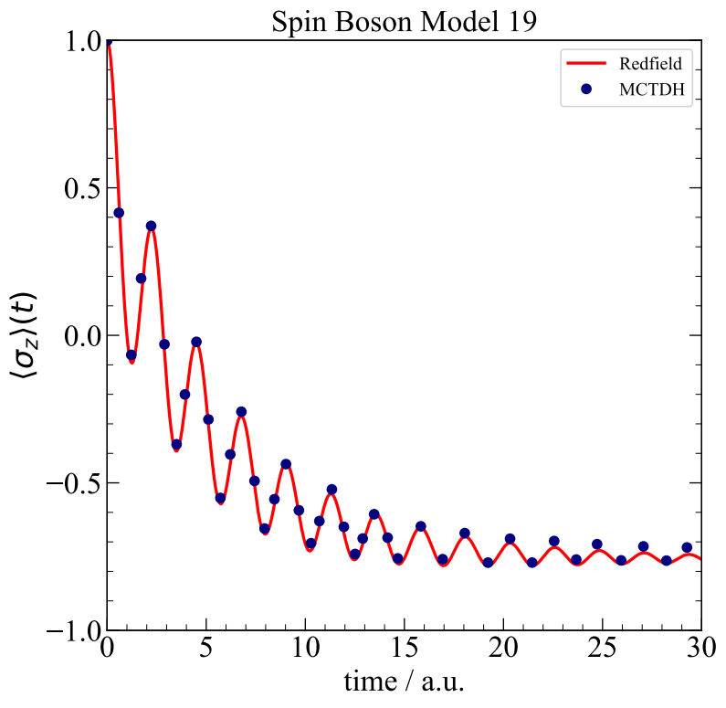

Slide 14
The Fenna-Matthews-Olson (FMO) pigment-protein complex

Slide 15
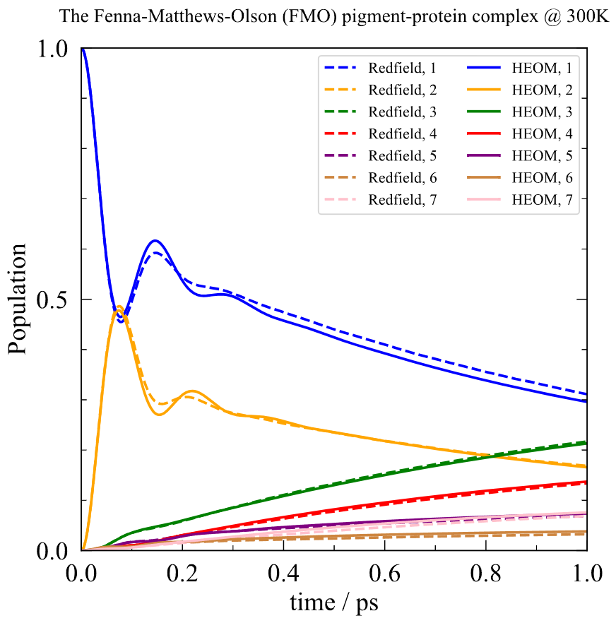
Short time behaviors (1 ps)
Long time behaviors (10 ps)

Slide 16
Short time behaviors (1 ps)
Long time behaviors (10 ps)

